Slide 1
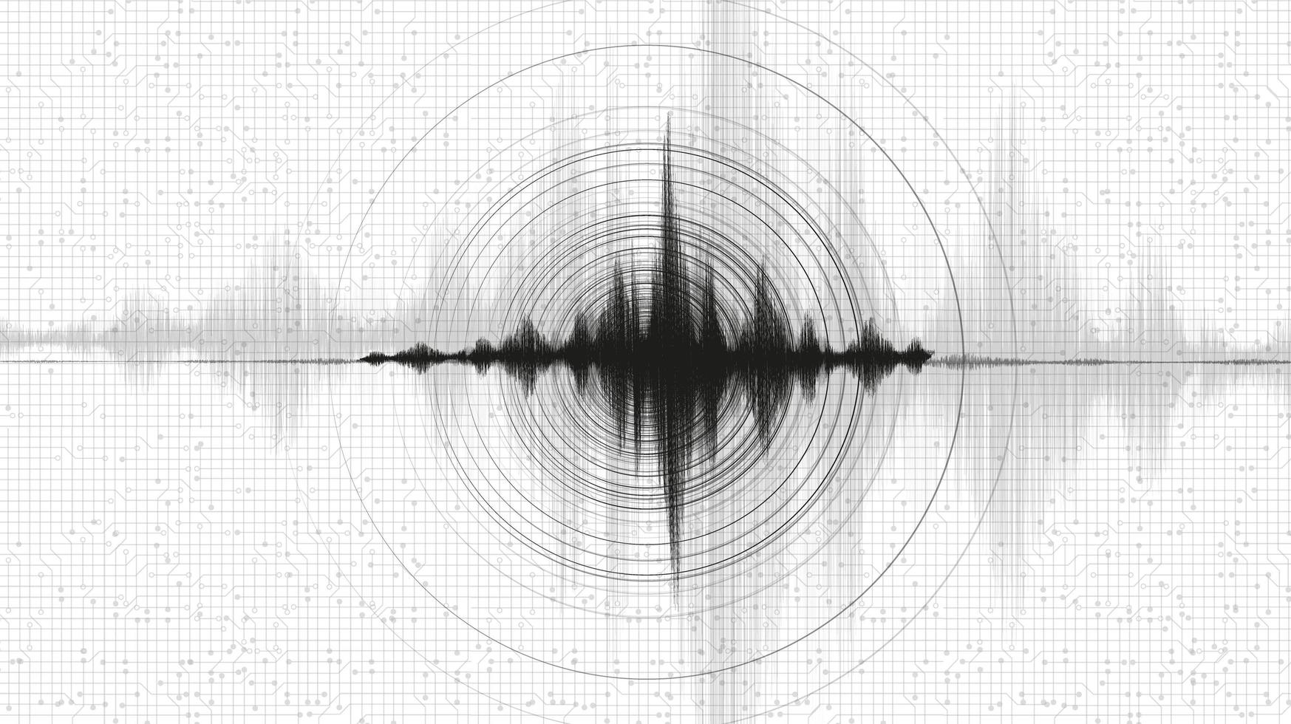
Modern Seismology and Geophysics Analysis
By: Elijah Taber, Michael Speer, Caleb Trimble

Slide 2
Project Hypothesis & Goals
Hypothesis: Earthquake clusters near tectonic boundaries correlate with higher magnitudes and shallower depths.
Business Relevance:
Refine risk maps for governments and insurers.
Improve sensor deployment and data accuracy.
Data Source: USGS Earthquake Catalog (30-day global dataset).

Slide 3
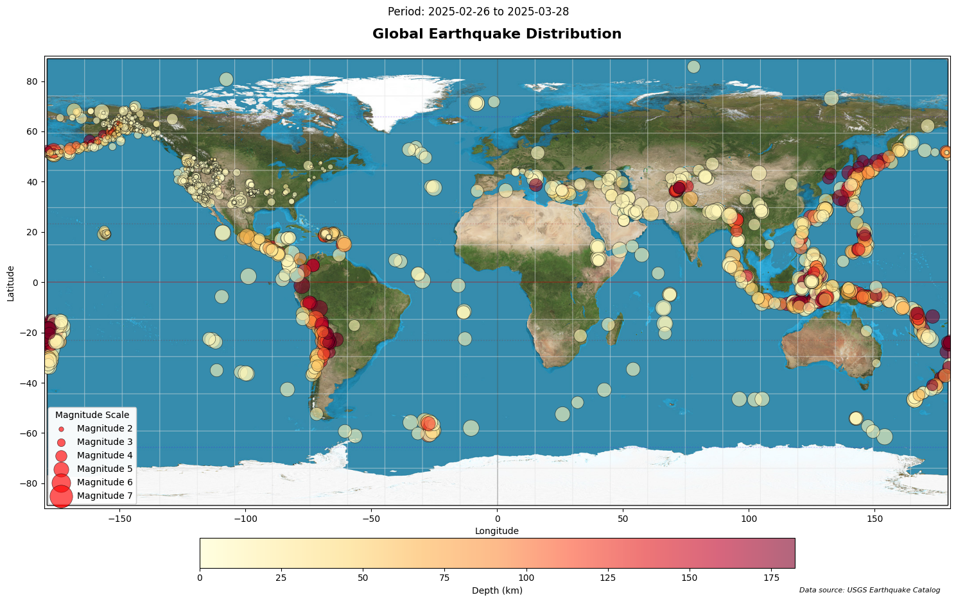

Slide 4
The Significance of Earthquakes
Among the most destructive natural hazards worldwide, causing loss of life, infrastructure damage, and economic disruption.
Annual economic losses often run into the tens of billions of dollars.
High‑risk zones, such as the Pacific Ring of Fire, house the majority of seismic activity.
Preparedness and mitigation are critical to reducing human and financial tolls.

Slide 5
What Exactly Is An Earthquake?
A sudden release of accumulated strain energy in the Earth’s lithosphere, generating ground shaking and sometimes surface rupture.
Energy radiates outward as seismic waves: Primary (P), Secondary (S), and surface waves.
Occurs along faults—fractures where blocks of crust move relative to each other.
Drives the formation of mountain ranges, rift valleys, and other large‑scale geological features.

Slide 6
Seismic Waves Characterization
P‑waves (Primary): Fastest, compressional; first to arrive.
S‑waves (Secondary): Shear waves; slower but more damaging.
Surface waves: Slowest; cause the most severe ground motion.
Magnitude (M_w): Estimates released energy; each unit increase ≈ 32× more energy.
Depth (km): Shallow (< 70 km) vs. deep-focus quakes (>300 km), impacts surface shaking.
Epicenter (lat/long): Surface point above the hypocenter. ​

Slide 7
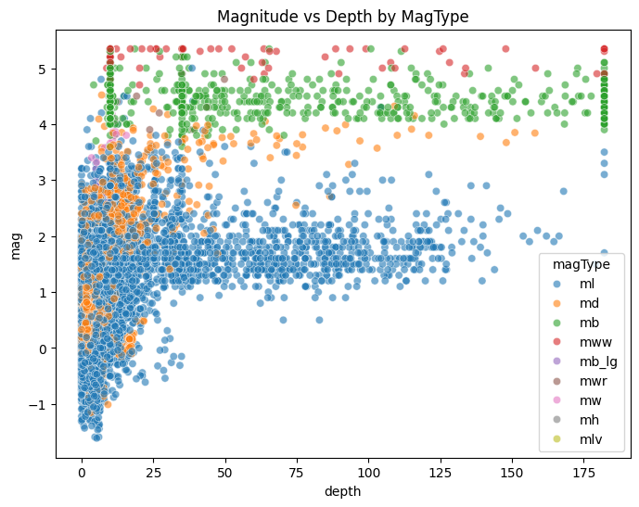

Slide 8
Why Can’t We Predict Earthquakes?
Currently there is no way known method to accurately predict earthquakes due to stress accumulation, fault heterogeneity, and chaotic crust dynamics.
We would need instruments that can directly measure the tectonic plates that are hundreds to thousands of km below the surface of the Earth.

Slide 9
What Can We Do?
Identify high risk zones that are close to, or directly on top of, active fault lines.
Implement early warning systems to detect P-Waves to alert us before the more powerful S-Waves arrive and cause damage.
Identify currently active tectonic regions that indicate an accumulation of energy that is being released.

Slide 10
References
https://www.vecteezy.com/free-vector/seismic-waves
https://pngtree.com/freebackground/graphic-of-a-fractal-wave-with-moving-lines-on-a-black-background_3507322.html
https://earthquake.usgs.gov/earthquakes/feed/v1.0/summary/all_month.csv
https://www.usgs.gov/programs/earthquake-hazards/magnitude-types

